Slide 1

BACHELOR OF TECHNOLOGY
IN
Artificial Intelligence and Machine Learning
LIVER DISEASE PREDICTION USING DEEP LEARNING
Batch Number: AT5
Project Guide Batch Names & Roll Numbers:
prof. Veena Rani A. Sri Charan 2011CS020019
A. Surya pavan 2011CS020020
A.V.S. Pavan 2011CS020021
A. Vijay 2011CS020022
Department of AIML, School of Engineering
Malla Reddy University

Slide 2
PROBLEM STATEMENT
A comparative study on Liver Disease Prediction Using deep learning algorithms

Slide 3
ABSTRACT:
Liver, a crucial interior organ of the human body whose principal tasks are to eliminate generated waste produced by our organism, digest food, and preserve vitamins and energy materials.
The liver disorder can cause various fatal diseases, including liver cancer.
Early diagnosis, and treating the patients are compulsory to reduce the risk of those lethal diseases.
Liver disease can be predicted using deep learning techniques.

Slide 4
INTRODUCTION
Liver, a crucial interior organ of the human body whose principal tasks are to eliminate generated waste produced by our organism, digest food, and preserve vitamins and energy materials.
The liver disorder can cause various fatal diseases, including liver cancer. Early diagnosis, and treating the patients are compulsory to reduce the risk of those lethal diseases.
A dataset was chosen to train and test this model. Indian Liver Patient Dataset obtained . We implemented different deep learning algorithms (Multi-Layer Perceptron, Stochastic Gradient Descent, Restricted Boltzmann) and filtered out the DL-based MLP (Multi-Layer Perceptron) model as the one providing the highest Accuracy.

Slide 5
LITERATURE SURVEY
Liver disease prediction using machine learning and deep learning: A comparative study
Article type: Research Article
Authors: Singla, Bhawna | Taneja, Soham | Garg, Rishika | Nagrath, Preeti
Affiliations: Panipat Institute of Engineering and Technology, Panipat, India,
Bharati Vidyapeeth’s College of Engineering, Delhi, India

Slide 6
OBJECTIVE
To predict Liver disease using deep learning techniques
Our main aim is to find the accuracy of liver disease prediction provided by different deep learning algorithms.
Using multilayer perceptron, gradient descent, Restricted Boltzmann algorithms to find accuracy of liver disease.

Slide 7
EXISTING SYSTEM
The liver disease prediction is performed by various machine learning techniques.
Algorithms like support vector machine, decision trees, Random forest, k nearest neighbour, naïve bayes etc are performed to predict liver disease prediction
But due to the large amount of data obtaining accuracy was difficult through machine learning techniques.

Slide 8
PROPOSED SYSTEM
For obtaining high accuracy we used deep learning techniques for liver disease prediction.
Deep learning techniques like multilayer perceptron, restricted Boltzmann and gradient descent are performed on the dataset.
Among the algorithms multilayer perceptron algorithm gives highest accuracy for liver disease prediction.

Slide 9
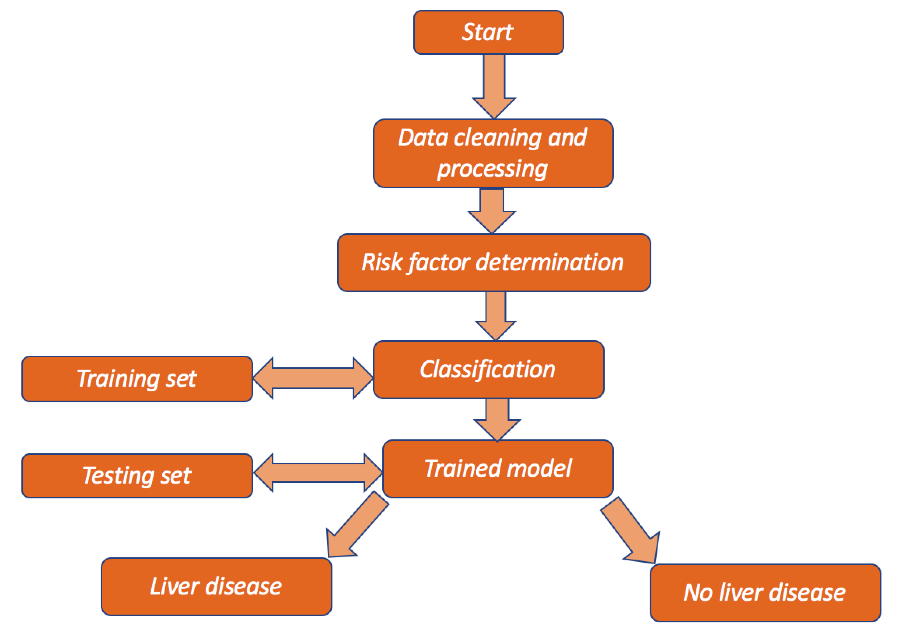
ARCHITECTURE

Slide 10
METHODS AND ALGORITHMS
Input the existing data set which is already categories as per the liver disease prediction.
Multilayer perceptron
Restricted Boltzmann
Gradient descent

Slide 11
RESULTS AND CONCLUSION:
The observed results are :
Deep learning algorithms provide more accurate results than machine learning algorithms
Among deep learning algoritms multilayer perceptron provides highest accuracy rate i,,e 0.73

Slide 12
THANK YOU

